Slide 1

New Hanover
Comprehensive Plan
Maggie Dobbs, AICP
August 14, 2019

Slide 2
Timeline
 | 2019 |  |  |  |  |  |  |  |  | 2020
 | 4 | 5 | 6 | 7 | 8 | 9 | 10 | 11 | 12 | 1 | 2 | 3 | 4 | 5 | 6 | 7 | 8 | 9 | 10
Background Research
Goals Identification
Stakeholder Interviews
Survey
Strategies Identification
Workshop
Draft Writing
Open House
Draft Review
Adoption

Slide 3
Agenda
Review of topic: Transportation
Final review of survey questions
Introduction of Comprehensive Plan Logo options
  See attached document
  To be updated with township seal
Next steps

Slide 4
Comp Plan Topic Schedule
2019
  May
    Preliminary issues identification
    Survey development
  June
    Housing and Population
    Survey development
  July
    Parks and open space
    Survey development
  August
    Transportation
    Survey finalization
  September (Survey launch)
    Natural and historic resources
  October
    Economic development
  November (Community Workshop)
    Workshop preparation
  December
    Future land use
2020
  January
    Community facilities and utilities
  February
    Government
  March
    Strategies development
  April
    Implementation chart development
  May (Open House)
    Open House preparation
  June
    Open House feedback review
  July – October
    Review of draft plan

Slide 5
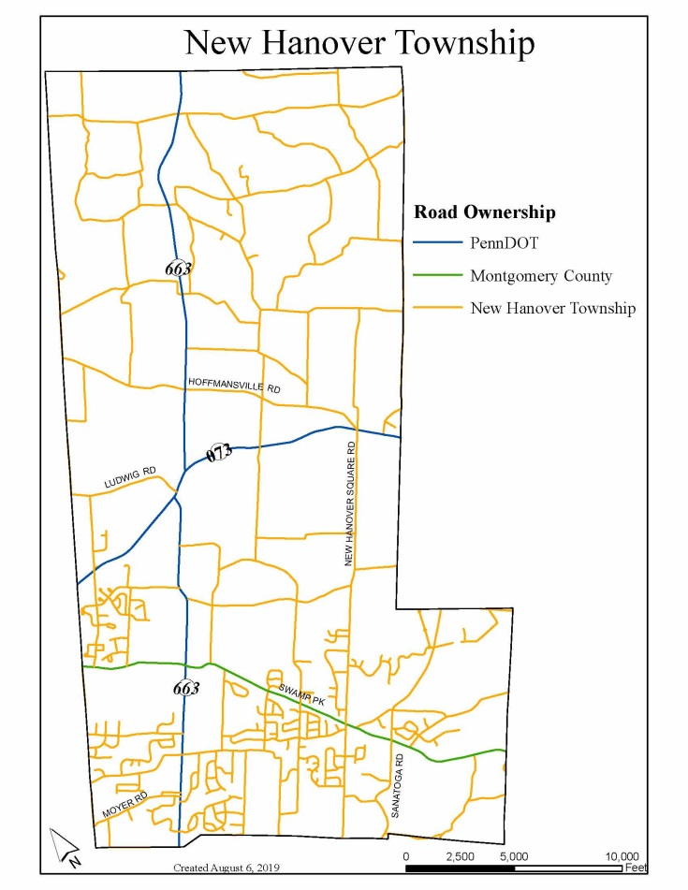
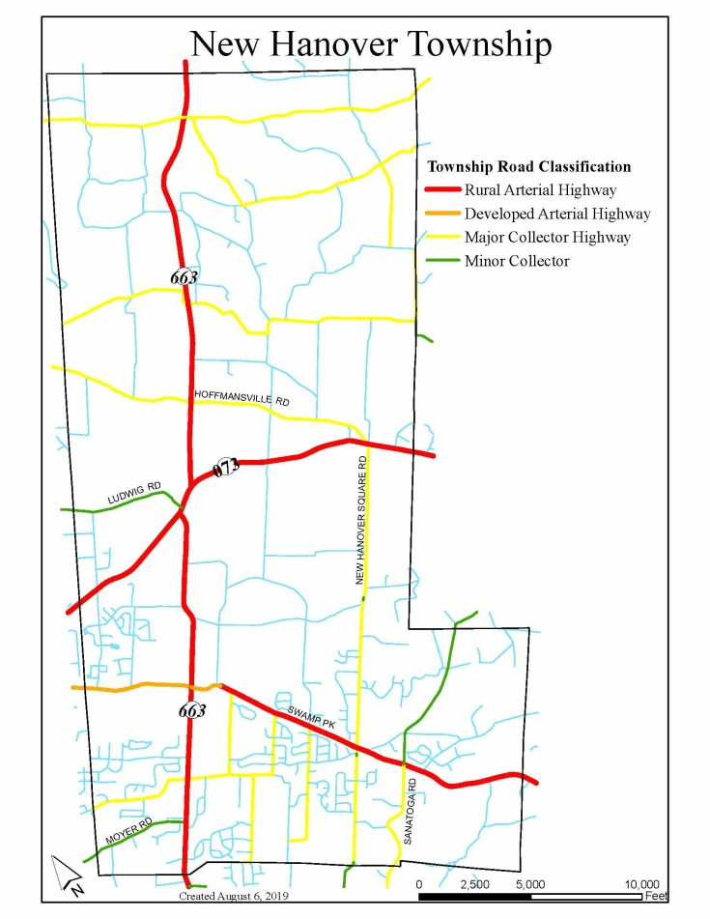
Road Network
Ownership
Classification

Slide 6
Vehicle Ownership
Travel Time to Work
Less than 10 minutes | 5.6%
10 to 14 minutes | 8.1%
15 to 19 minutes | 12.3%
20 to 24 minutes | 12.0%
25 to 29 minutes | 3.8%
30 to 34 minutes | 11.4%
35 to 44 minutes | 10.7%
45 to 59 minutes | 16.7%
60 or more minutes | 19.3%

Slide 7
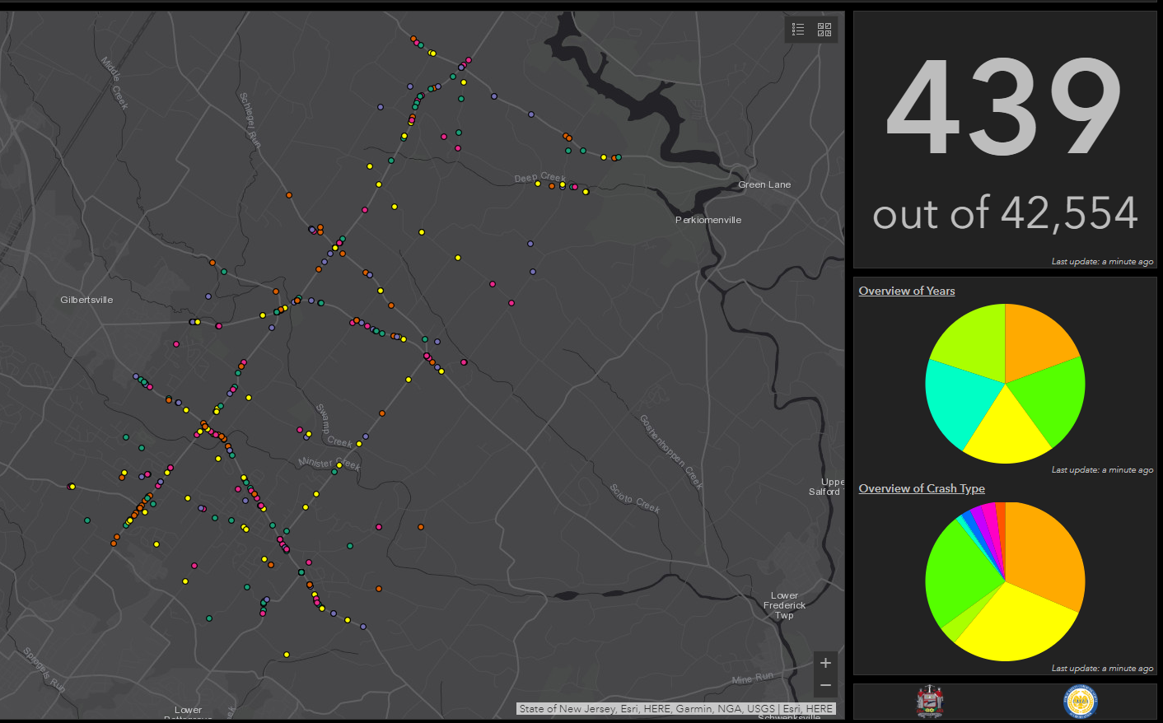
Road Safety
Notes:
Even distribution of crashes per year. Yellow – rear end, green – fixed object, orange – angle, pink – head on

Slide 8
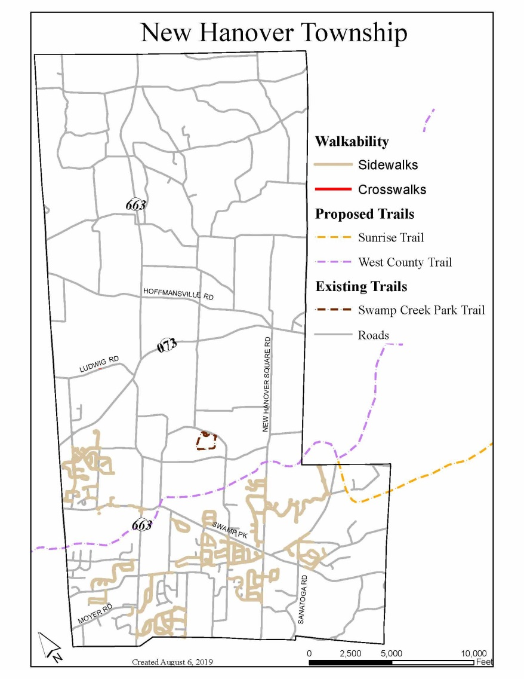
Non-Vehicular Transportation Network
Sidewalks are limited to newer developments in southern half of twp
Limited connectivity to parks and commercial destinations

Slide 9
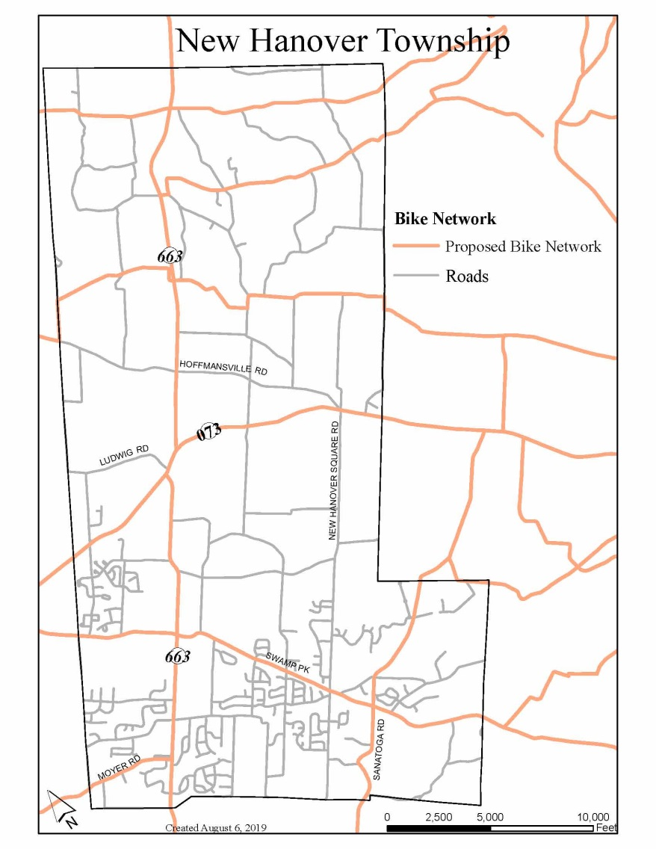
Bike Network
Options include:
  Protected Bicycle Lanes
  Buffered Bicycle Lanes
  Bicycle Lanes (Standard)
  Paved Shoulder
  Marked Shared Lanes or Sharrows
  Wide Outside Lane
  Shared-use Path or Sidepath
  Bicycle Boulevard
  Shared Lanes (No Provisions) on
  Low-Volume Roads

Slide 10
Values Identification
Increasing development is bringing more traffic on local roadways which increases congestion, wear and tear on the roads, and can result in more crashes.
Road projects are costly and complicated, but necessary for safety and mobility. What value do you place in prioritizing these types of projects?
Where are areas of main concern?

Slide 11
Values Identification
Connectivity for all modes of transit – vehicular, pedestrian, bicycle – is limited.
What type of connections are most valuable to the community?
Where do you want these connections to occur?

Slide 12
Values Identification
No public transportation options exist within the township. New extensions on the PART orange line will expand service to Boyertown.
Is there interest in pursuing bus service extension to NHT should the Town Center project be constructed?
Is there any additional interest or demand in improving access to PART or SEPTA services?

Slide 13
Survey Questions
Please provide any other thoughts or feedback on the survey questions.

Slide 14


Comprehensive Plan Logo Options

Slide 15


Comprehensive Plan Logo Options

Slide 16


Comprehensive Plan Logo Options

Slide 17
Next Steps…
Submission to PC of background materials on upcoming topics
  September: Natural and Historic resources, Survey launch
  October: Economic Development
MCPC will:
  Finalize plan logo
  Administer online and paper survey
    Online survey will launch September 2

Slide 18
Questions or comments?
Maggie Dobbs, AICP
610 292-4917
mdobbs@montcopa.org

